Slide 1

Feeling Safe, Being Safe
Marcie Roth
Partnership for Inclusive Disaster Strategies
www.disasterstrategies.org
Mark Starford
The Board Resource Center
www.brcenter.org

Slide 2
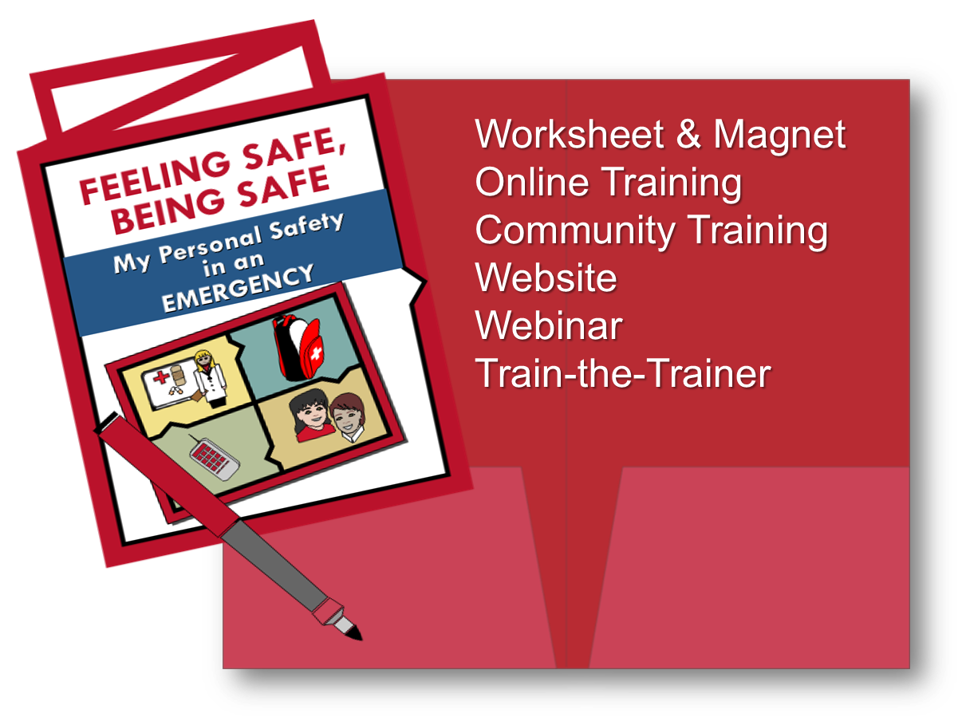
Feeling Safe Being Safe

Slide 3
Learning Objectives
Learn the value of end-user input throughout design and training.
Understand ways to adapt Feeling Safe, Being Safe tools and training for unique regional needs.
Learn basic methodologies to replicate Feeling Safe, Being Safe tools and training.

Slide 4
Feel Safe,
Be Safe
What is Feeling Safe, Being Safe?
Preparedness tools and training that can be easily understood and used to promote safety not fear
Personalized work sheet
Magnet for important information
Video and webinar series demonstrating how to build a to-go bag and value of community connections
Community training module
Train-the-Trainer module and video

Slide 5
12 Years
Why are we talking about it?
Started by people most likely to be excluded
For personal use and peer training
Family and community inclusive
Does not require ongoing government investment

Slide 6
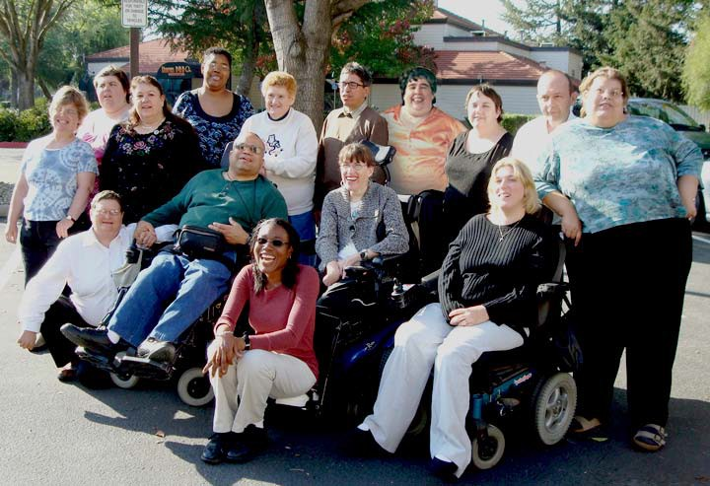
California Department of Developmental Services - Consumer Advisory Committee
2007
They demanded action!
By them, for them, about them
Be safe, not fearful

Slide 7
Motivation
THINK – PLAN - DO
Enhance preparedness for thousands of people with disabilities
Be viewed as community assets that assist others
Design easy-to-use tools and process
Adaptable across populations and locations
Simple method that empowers people to take action

Slide 8
Principles
Nothing about me, without me
People have the right to understandable information
Clear language increases participation in personal safety
Taking personal responsibility for my own safety
Becoming an asset to the community

Slide 9
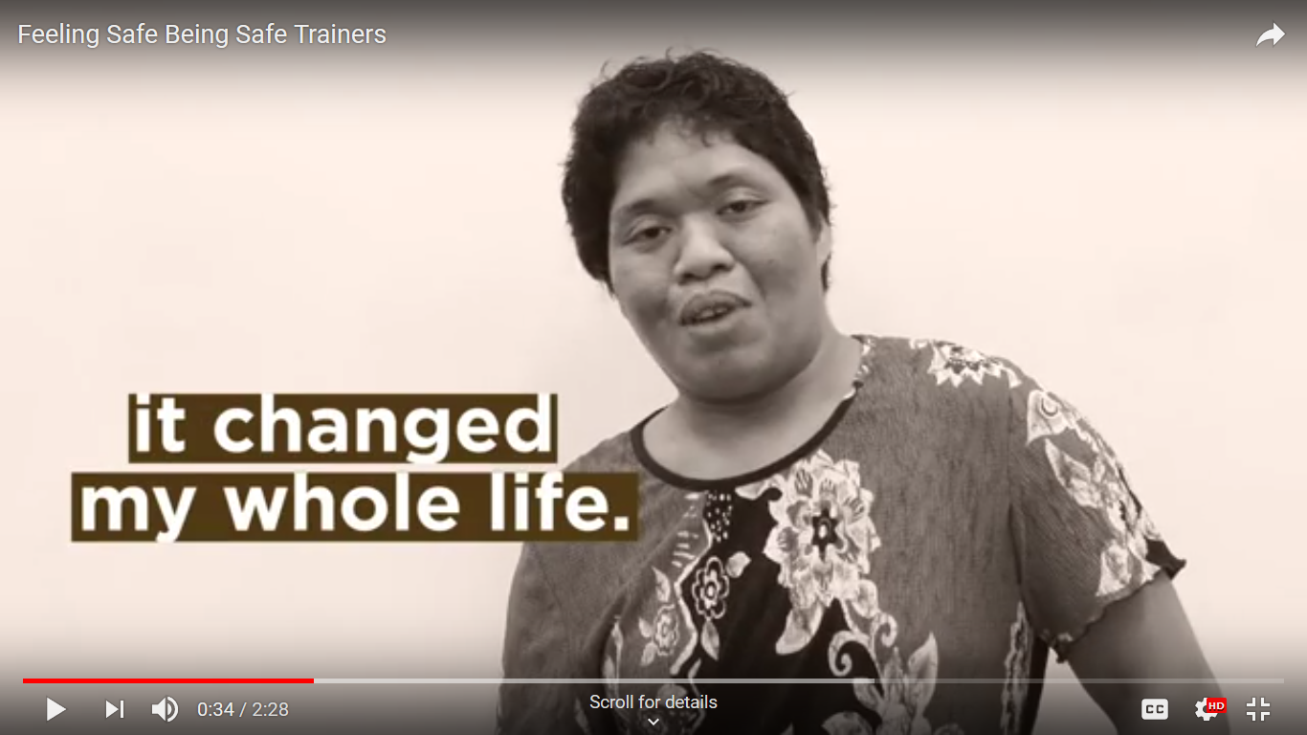
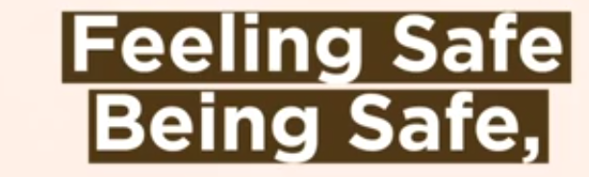
University of Hawaii Center for Disability Studies
Feeling Safe, Being Safe Video
2.14 stop:
https://www.youtube.com/watch?v=MqKPYaSQAYw

Slide 10
Method
Methodology
Survey people to find out what they know
Use Easy English (everyday language)
Design icons and symbols
Need to know information only
Use short sentences
Design tools that are actionable

Slide 11
Survey
What does your audience know?
Define the audience
What do they already know?
What do they need to know?
What questions will they have?
What do we want as an outcome?
Test drafts with representatives

Slide 12
Outcomes
Trainers as Community Assets
Sustainable approach
Original tools expanded for children
Feeling Safe trainings held in many states
Easy adaptation of tools
Permanent webpage on California DDS website

Slide 13
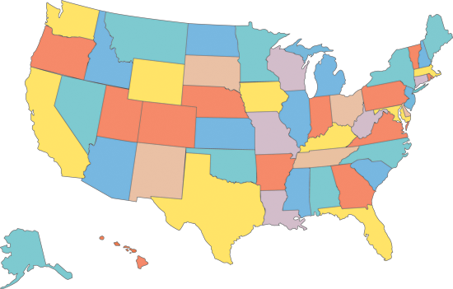


Map of Implementation and Adaptation Locations

Slide 14
Outreach
Outreach
National and International Outreach
National Disability and Health Conferences
Center for Plain Language, Washington, DC
International Plain Language Association, Lisbon Portugal
World Bank – Haiti Recovery, Washington, DC
United Nations Promising Practice, New York, NY

Slide 15
Take Away
Why It Works
People with disabilities lead the way
User involvement in all phases
Community inclusive training
Peer to peer advocacy
Sustainable system support

Slide 16
Feeling Safe,
Being Safe
Why we are talking about this 12 years later
Part Two
National Preparedness Goal has acknowledged that engaging the whole community is essential
UN Economic and Social Commission for Asia and the Pacific- Make the Right Real eLearning
What we know
Planning with and not planning for
Billions are spent on preparedness
Most initiatives do not adequately include the whole community
2017 GAO Report on preparedness investments

Slide 17
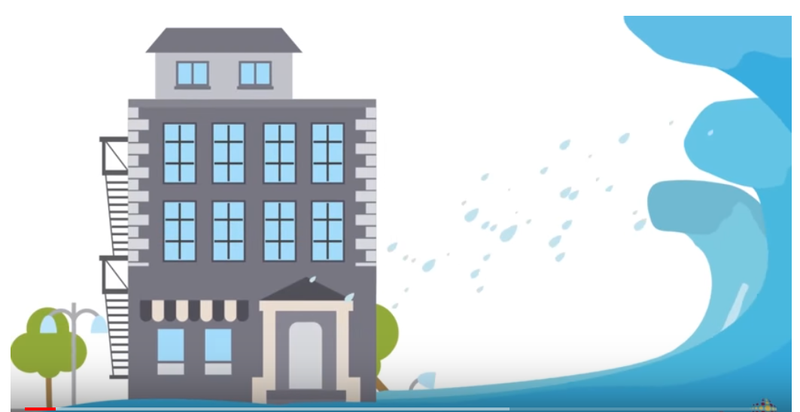

Leave no one behind with Disability Inclusive DRR
https://www.youtube.com/watch?v=CbLTPQsF1AQ

Slide 18
Going Forward
Feeling Safe, Being Safe strategy should be a model for where we go from here
Investing in initiatives
Building resilience at community level
Engaging the whole community is essential to the nations success in achieving resilience and national preparedness
Whole community contributions to national preparedness
Nothing about without us

Slide 19
Self-Determination
People with disabilities are the most knowledgeable about their own
needs.
Whenever choices are available, people with disabilities have the right to choose their shelter location, what type of services they require, and who will provide them.

Slide 20
Antidiscrimination Principles
No “One Size Fits All”
People with disabilities do not all require the same
assistance and do not all have the same needs.

Slide 21
Antidiscrimination Principles
Effective Communication
People with disabilities must be given information comparable in content and detail to that given to the general public, as well as
accessible, understandable, and timely.

Slide 22
Community Resilience
Resilience is the ability to anticipate risk, limit impact, and
bounce back rapidly through survival, adaptability, evolution,
and growth in the face of turbulent change
True resilience is only achievable with a full commitment to
equal access and whole community inclusion

Slide 23
Disability Impacts All of Us

Slide 24
Fast Facts
FEMA reported that roughly 47 million people were affected by hurricanes Harvey, Irma, and Maria — 8% of the entire U.S. population
The CDC reports that 26% of the population has disabilities, this indicates that over 12 million of these disaster impacted individuals were children and adults with disabilities.
The 2011 World Report on Disability stated “What happens to people with disabilities has a direct impact not only on them but on the rest of the society, especially their families and communities”.

Slide 25
Fast Facts
According to the UN, “children and adults with disabilities and older adults are 2-4 times more likely to be injured or die in a disaster due to lack of planning, accessibility and accommodation, most are not due to diagnostic labels or medical conditions”
The UN Sendai Framework for Disaster Risk Reduction recognizes
that “not only are persons with disabilities disproportionately affected by disasters, but – crucially – that their knowledge and leadership skills are essential for building resilient, inclusive and equitable societies”
United Nations Sendai Framework for Disaster Risk Reduction - 2015-2030
DISPROPORTIONATE IMPACT

Slide 26
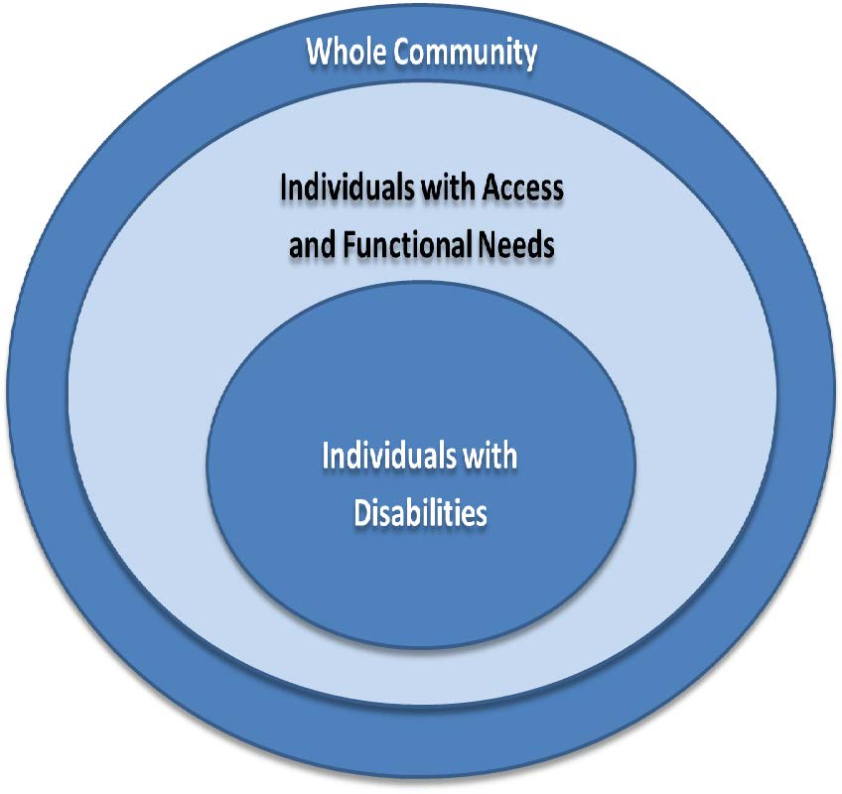
Individuals with Disabilities and Individuals with
Access and Functional Needs make up most of the
Whole Community

Slide 27
US Government Accountability Office
February 2017
FEMA should expand access to key training on incorporating access and functional needs into emergency planning.
FEMA should take necessary steps to ensure its key training on incorporating access and functional needs into emergency planning reaches a sufficiently wide audience.

Slide 28
Preparedness
According to DHS, from fiscal years 2002 through 2017 the department has awarded over $49 billion to a variety of DHS preparedness grant programs to enhance the capabilities of state, local, tribal, and territorial grant recipients.
Over a 15-year period, HHS awarded about $3 billion to states and others to respond to specific disease threats, such as Zika, Ebola, and H1N1 pandemic influenza.
HHS awarded an additional $18 billion for more general public health preparedness and capacity-building activities, such as getting ready for infectious disease threats and terrorist events.

Slide 29
Community Resilience
True resilience is only achievable with a full commitment to equal access and whole community inclusion.

Slide 30
Nothing About Any of Us, Without All of Us

Slide 31
Disability Inclusive Disaster Preparedness
Feeling Safe Being Safe
http://brcenter.org/lib/FSBS.php
https://www.dds.ca.gov/ConsumerCorner/fsbs/
Inclusive Disaster Risk Reduction - A Whole Community Action
https://www.maketherightreal.net/learning
Inclusive Emergency Management 101: Integrating the Disability Community in Disaster Planning and Response
http://inclusive-em-101.online/courses/inclusive-emergency-management-101-integrating-the-disability-community-in-disaster-planning-and-response/

Slide 32
Marcie Roth
Partnership for Inclusive Disaster Strategies
marcie@disasterstrategies.org
www.disasterstrategies.org
Mark Starford
The Board Resource Center
mark@brcenter.org
www.brcenter.org

